Slide 1
Overcoming Therapeutic Inertia (OTI) in Type 2 Diabetes
Benefiting Patients, Clinicians,
and Health Systems
therapeuticinertia.diabetes.org
Overcoming Therapeutic Inertia, an initiative from the American Diabetes Association®, is supported by strategic sponsors AstraZeneca and Sanofi US Services Inc., and supporting sponsors Merck and Novo Nordisk Inc.
Notes:
The purpose of this presentation is to build awareness of the problem of therapeutic inertia in people with type 2 diabetes (T2D) and advocate for making changes to overcome it.

Slide 2
Type 2 Diabetes is a Pressing Health Issue
Affects over 37.3 million Americans
11% of the population
Consumes 1 in 4 health care dollars
60% higher risk of early death
Higher risk of blindness, kidney failure, heart disease, stroke, and loss of limb
American Diabetes Association. Economic costs of diabetes in the US in 2017. Diabetes Care. 2018 May;41(5):917–928.
Notes:
There are over 37.3 million Americans who are affected by diabetes. That is more than 11 percent of the US population. Diabetes management consumes one out of every four health care dollars. A diabetes diagnosis results in 60% higher risk of early death and higher risk of blindness, kidney failure, heart disease, stroke and loss of limb.

Slide 3
Achieving glycemic control improves health outcomes yet proportion of patients who achieved A1C <7% declined 11% over 12 years**
*Edelman S, Polonsky W. Diabetes Care 2017, 40:1425-1432
**Fang M, et al. NEJM June 10, 2021
Notes:
Diabetes control in the U.S. population has steadily declined over the past 20 years, as evidenced by the gold-standard measure of A1C.
The figure on the screen shows that only 50.5% of people with diabetes meet the goal of A1C <7%.

Slide 4
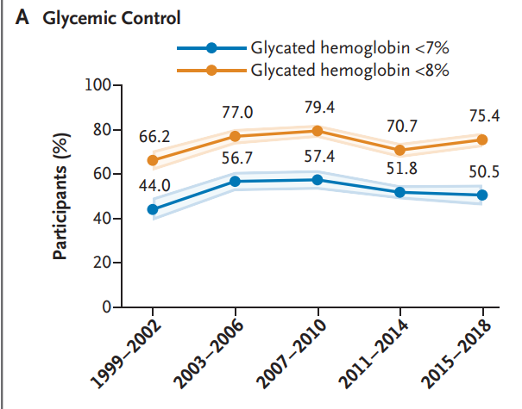
Prevalence of Glycemic Control
Advances in health technology, policy, and newer medications have failed to improve glycemic control.
Fang M, et al.Trends in Diabetes Treatment and Control in U.S. Adults, 1999–2018. NEJM 2021;384:2219-2228.
Notes:
Here are the results of another study from the National Health and Nutrition Examination Survey (NHANES). It shows glycemic management data of people from 1999 through 2018 who were not pregnant and were 20 years of age or older.
The data reveals that glycemic management has been stagnant for years despite a) advances in medications, b) development of new glycemic monitoring devices, c) medication delivery methods, and d) healthcare policies.
The figure shows that the percentage of adults achieving A1C <7% increased up until 2010 but declined to 50.5% by 2018.

Slide 5
Failure to initiate or intensify therapy when health parameters are not met, despite:
Clear definition of appropriate targets
Benefits of achieving the targets are well established
Effective therapies are available
Evidence-based clinical guidelines/algorithms are widely disseminated
Therapeutic Inertia
A major contributor to failure to meet glycemic goals
Present at all stages of treatment intensification
Philips LS, et al. Clinical Inertia. Annals of Intern Med 2001;135:825
Notes:
There has been a lot of advancements in diabetes management such as clearly defined targets, the benefits of achieving targets in a timely manner, the number of available therapies as well as clinical guidelines and algorithms, glycemic management fails to improve. One of the reasons that glycemic management fails to improve even with advancements is Therapeutic Inertia (TI).
TI is the failure to start medication therapy, intensify therapy by changing a medication, a dose or combining medications, or even de-intensify therapy if goals for the person with diabetes are not being met.
TI can be present at diagnosis or at any stage along the patient’s treatment journey.

Slide 6
“Wait and See” and “Treat to Fail” Delays Therapy Intensification for People Not Meeting Glycemic Targets
Notes:
The timeline on the screen shows that substantial inertia exists in years–not months at each possible step in the patient’s therapeutic journey.
The wait-and-see approach, or treat until the medication, for example, oral anti diabetic drugs (OAD) or insulin fails, can mean that people with type 2 diabetes (PWT2D) spend years in hyperglycemia.
The “Wait and See” and “treat until a medication fails” approach often happens AFTER the diagnosis has been delayed or considerable inertia has occurred in initiating a medication.

Slide 7
When Managing Type 2 Diabetes, Timing is Important
Notes:
Time: The key concept in therapeutic inertia is acting quickly to achieve glycemic targets and A1C goals within 6 months to 1 year of treatment.
In addition to setting up the individualized therapeutic goal with shared decision-making between the health care professional and the person with diabetes.
The amount of time it takes to get there is EXTREMELY important.

Slide 8
Achieving Early Glycemic Control Leads to Better Outcomes
Generates a positive legacy effect (metabolic memory)
Diabetes Trials Unit. UKPDS Post Trial Monitoring. UKPDS 80 Slide Set. Available at: http://www.dtu.ox.ac.uk/index.php?maindoc=/ukpds/. Adapted from Holman RR, et al N Eng J Med. 2008; 359:1577-1789; UKPDS 33. Lancet.1998; 352: 837-853
Notes:
The initial study period of the UK Prospective Diabetes Study (UKPDS) showed that patients in intensive treatment with lower A1C had significant reductions in microvascular complications. However, they had no significant reductions in cardiovascular complications.
Interestingly, follow up studies showed that even though differences in A1C were lost over time, patients in the initial intensive arm continued to have significant microvascular complications and significant reduction in cardiovascular complications.
UKPDS and other landmark trials showed early glycemic control creates a legacy of better long-term health outcomes, even after glycemic control wanes.

Slide 9
Legacy Effect Exists Outside Clinical Trials: Managed Care Patients with Type 2 Diabetes
Diabetes control during the first year after diagnosis is strongly associated with lower future risk for diabetes complications and mortality underscoring urgency for early intensive treatment.
A1C >7% in first year after diagnosis
20% increased risk of future mortality
A1C >8% in first year after diagnosis
29% increased risk of microvascular events and 32% increase in all cause mortality
Laiteerapong N, Ham S, Goo Y, et al. Diabetes Care 2019;42:416-0426
Notes:
Real world data supports UKPDS clinical trial data. In a cohort study of over 34,000 people with type 2 diabetes (PWD) in a managed care population in northern California, patients were followed for 13 years following diagnosis. The impact of glycemic burden was evaluated at various points.
Among patients with 10 years of survival after diabetes diagnosis, the results showed the following:
A1C levels ≥7.0% (≥53 mmol/mol) for the 1st year after diagnosis were associated with an increased risk of future mortality.
Increasing periods of exposure to A1C levels ≥8.0% (≥64 mmol/mol) were associated with an increased risk of microvascular events and mortality.
This study suggests that the legacy effect exists outside of trial populations. It begins as early as the 1st year after diagnosis and depends on the level of glycemic exposure. These findings underscore the urgency of early diagnosis of diabetes and the future consequences of failing to achieve near-normal glycemia soon after patients are diagnosed with diabetes.

Slide 10
Legacy Effect Exists Outside Clinical Trial: Reduces Diabetes Related Costs
Retrospective Claims Analysis:
21,171 adults with type 2 diabetes and A1C >7% followed for 18 months
Action
Providers took action to intensify therapy in first 6 months
Diabetes-related outpatient costs were 60% higher when no action taken*.
No Action
Providers did not act to intensify therapy in first 6 months
*P <.0001
Mehta R, et al. Journal of Clinical & Translational Endocrinology. 19 (2020)
Notes:
A retrospective claims analysis of >21,000 adults with type 2 diabetes (T2D) followed for 18 months found that if their providers did not take action to intensify therapy within the first 6 months of treatment, their outpatient costs were 60% higher than when providers acted in the first 6 months to intensify therapy.

Slide 11
Delaying Treatment One Year Increases Clinical and Economic Burden
In Health Economic Modeling
Burden of delaying treatment intensification by 1 year in 13.4 million people with type 2 diabetes above target goals (A1C >9%) can result in:
Loss of 13,390 life years
$7.3 billion USD
Ali SN, Dang-Tan T, Valentine WJ, Hansen BB.
Evaluation of the Clinical and Economic Burden of Poor Glycemic Control
Associated with Therapeutic Inertia in Patients with Type 2 Diabetes in the United States.
Advances in therapy. 2020;37:869-882
Notes:
The potential glycemic and financial burden to individuals and our healthcare system can be calculated through health economic modeling. DELAYING intensifying treatment by a year results in enormous costs in loss of lives and resources.
Glycemic control is one goal of therapy and new medications such as SGLT2 and GLP-1 Ras have benefits of reducing future renal, and cardiovascular complications that drive future cost.

Slide 12
Achieving Early Glycemic Control Benefits:
Lower
A1C & glycemic burden
Better maintenance of A1C control over time
Better long-term health outcomes
Lower risk of microvascular & macrovascular complications.
Economic benefits
M Abdul-Ghani, C Puckett, et al. Initial combination therapy with metformin, pioglitazone and exenatide is more effective than sequential add-on therapy in subjects with new-onset diabetes. Results from the efficacy and durability of initial combination therapy for type 2 diabetes (EDICT): a randomized trial. Diabetes Obes Metab 2015; 17: 268–275.
D Mauricio, L Meneghini, et al. Change in insulin dose and HbA1c by geographical region—results from the diabetes unmet need with basal insulin evaluation (DUNE) Study. Diabetes 2018; 67(Suppl. 1). DOI: 10.2337/db18-1037-P.
U Desai, NY Kirson et al. Time to treatment intensification after monotherapy failure and its association with subsequent glycemic control among 93,515 patients with type 2 diabetes. Diabetes Care 2018; 41: 2096–2104.
Notes:
Summary of Key messages:
Early glycemic control, lowers A1C. Maintaining A1C near target over time lowers the risk of complication, improves health outcome and saves money.
Above adapted from this article:
S Khunti, K Khunti, et al.; Therapeutic inertia in type 2 diabetes: prevalence, causes, consequences and methods to overcome inertia; Ther Adv Endocrinol Metab; 2019, Vol. 10: 1–11

Slide 13
What Stakeholders Say is Needed to Reduce Therapeutic Inertia
Notes:
In 2018, the American Diabetes Association (ADA) asked stakeholders (healthcare professional, diabetes educators, PWD, health systems, and insurance companies) to explore how to reduce TI. As can be seen, effectively overcoming therapeutic inertia is complex.
Overcoming TI through education, collaboration, access and innovation are the major pillars ADA’s OTI initiative. The initiative is focused on promoting strategies to effectively reduce TI
Recognizing that TI can occur along the patient treatment journey for all PWD, the focus of the OTI initiative is on people with type 2 diabetes.

Slide 14
The Causes of Therapeutic Inertia are Multifactorial
People with diabetes
Clinicians & health care providers
Health care systems
Payors
Industry
Notes:
There are many factors affecting TI and health care professionals are just part of it. There are factors relating to people with diabetes, health systems, payors industry. There are things we can control, and others are out of our control. However, we can do much more than we think.

Slide 15
Most Frequently Cited Contributors to Therapeutic Inertia in People with Type 2 Diabetes
Clinician-Related Contributors
Time constraints and overwhelming requirements
Failing to use glycemic targets and goals to initiate, evaluate, or intensify treatment
Fear of aggressive therapy causing side effects (hypoglycemia)
Underestimating patients’ needs and abilities to manage their diabetes
Not referring to medical nutrition therapy (MNT) or diabetes self-management education and support (DSMES) services
Adapted from :G Reach, V Pechtner, et al.; Clinical inertia and its impact on treatment intensification in people with type 2 diabetes mellitus; Diabetes & Metabolism Vol 43, Issue 6, Dec. 2017, 501-511
Addressing Therapeutic Inertia in 2020 and Beyond: A 3-Year Initiative of the American Diabetes Association, Clinical Diabetes July 31, 2020
Notes:
Here is a list of clinician related factors.

Slide 16
Most Frequently Cited Contributors to Therapeutic Inertia in People with Type 2 Diabetes
Therapeutic Inertia-related Contributors for Persons with Diabetes
Social determinants of health (SDOH) issues including cost and access to medication/poor insurance coverage
Limited understanding of the progressive nature of diabetes and need for treatment to change with time
Poor access and participation in diabetes education and MNT
Poor communication/trust between physician and patient that enhances medication adherence
Adapted from :G Reach, V Pechtner, et al.; Clinical inertia and its impact on treatment intensification in people with type 2 diabetes mellitus; Diabetes & Metabolism Vol 43, Issue 6, Dec. 2017, 501-511
Addressing Therapeutic Inertia in 2020 and Beyond: A 3-Year Initiative of the American Diabetes Association, Clinical Diabetes July 31, 2020
Notes:
Here is a list of cited therapeutic inertia-related contributors among people with diabetes.

Slide 17
Most Frequently Cited Contributors to Therapeutic Inertia in People with Type 2 Diabetes
System-Related Contributors
Failing to identify patients not meeting targets
Lack of transparency or accuracy in formulary at point of care
Not providing and promoting access to DSMES services
No team approach to care
Insurance issues including medication switching
Adapted from :G Reach, V Pechtner, et al.; Clinical inertia and its impact on treatment intensification in people with type 2 diabetes mellitus; Diabetes & Metabolism Vol 43, Issue 6, Dec. 2017, 501-511
Addressing Therapeutic Inertia in 2020 and Beyond: A 3-Year Initiative of the American Diabetes Association, Clinical Diabetes July 31, 2020
Notes:
On your screen is a list of system–related contributors that hamper efforts to overcome therapeutic inertia.

Slide 18
OTI Strategic Drivers
Timely Therapy Optimization:
Improved Care Plan Adherence:
Both are critical but neither is sufficient on their own!
Inertia
Busting
Get to glycemic goal in <6 months
Empower team members and people with diabetes
Notes:
Timely therapy optimization is critical to overcome therapeutic inertia. It starts with identifying people with diabetes who are at high risk. Set treatment goals with shared decision-making. Modify treatment regimen timely.
Focus on improved care plan adherence: Ask about barriers and find solutions together with person with diabetes.
Clinicians should reflect on this question every visit and in between: Have I done everything in my power to tackle therapeutic inertia?

Slide 19
Meta-Analysis: Studies Categorized by Primary Type of Intervention
Care management and patient education-based
Virtual coaching
Self-management education
Telemonitoring
Point of care testing, alerts
Shared decision-making tools
Physician-based
Programs designed to influence physician behavior through education, in-person training, and support from specialists, feedback, or reminders
Nurse or certified diabetes care and education specialist-based
Provided medication management using protocols to initiate or intensify therapy
Pharmacist-based
Provided medication management using guidelines
Powell et al. Diabetes Obes Metab. May 2021
Notes:
Many studies were considered for inclusion in meta-analysis that was published in 2021. Over 1400 studies were screened and 36 were included in the meta-analysis.
Studies included all healthcare professionals associated with diabetes management including PCPs.
Interventions were grouped into 4 categories based on primary type of interventions and key elements and activities:
Care management and patient education-based, including virtual coaching, telemonitoring, point of care testing, alerts, shared decision-making (SDM) tools, practice advisories in EHR.
Physician-based, programs to influence physician behavior, education, feedback or reminders, practice QI programs.
Nurse or CDCES-based focusing on medication management using guidelines.
Pharmacists-based focusing on medication management with guidelines.

Slide 20
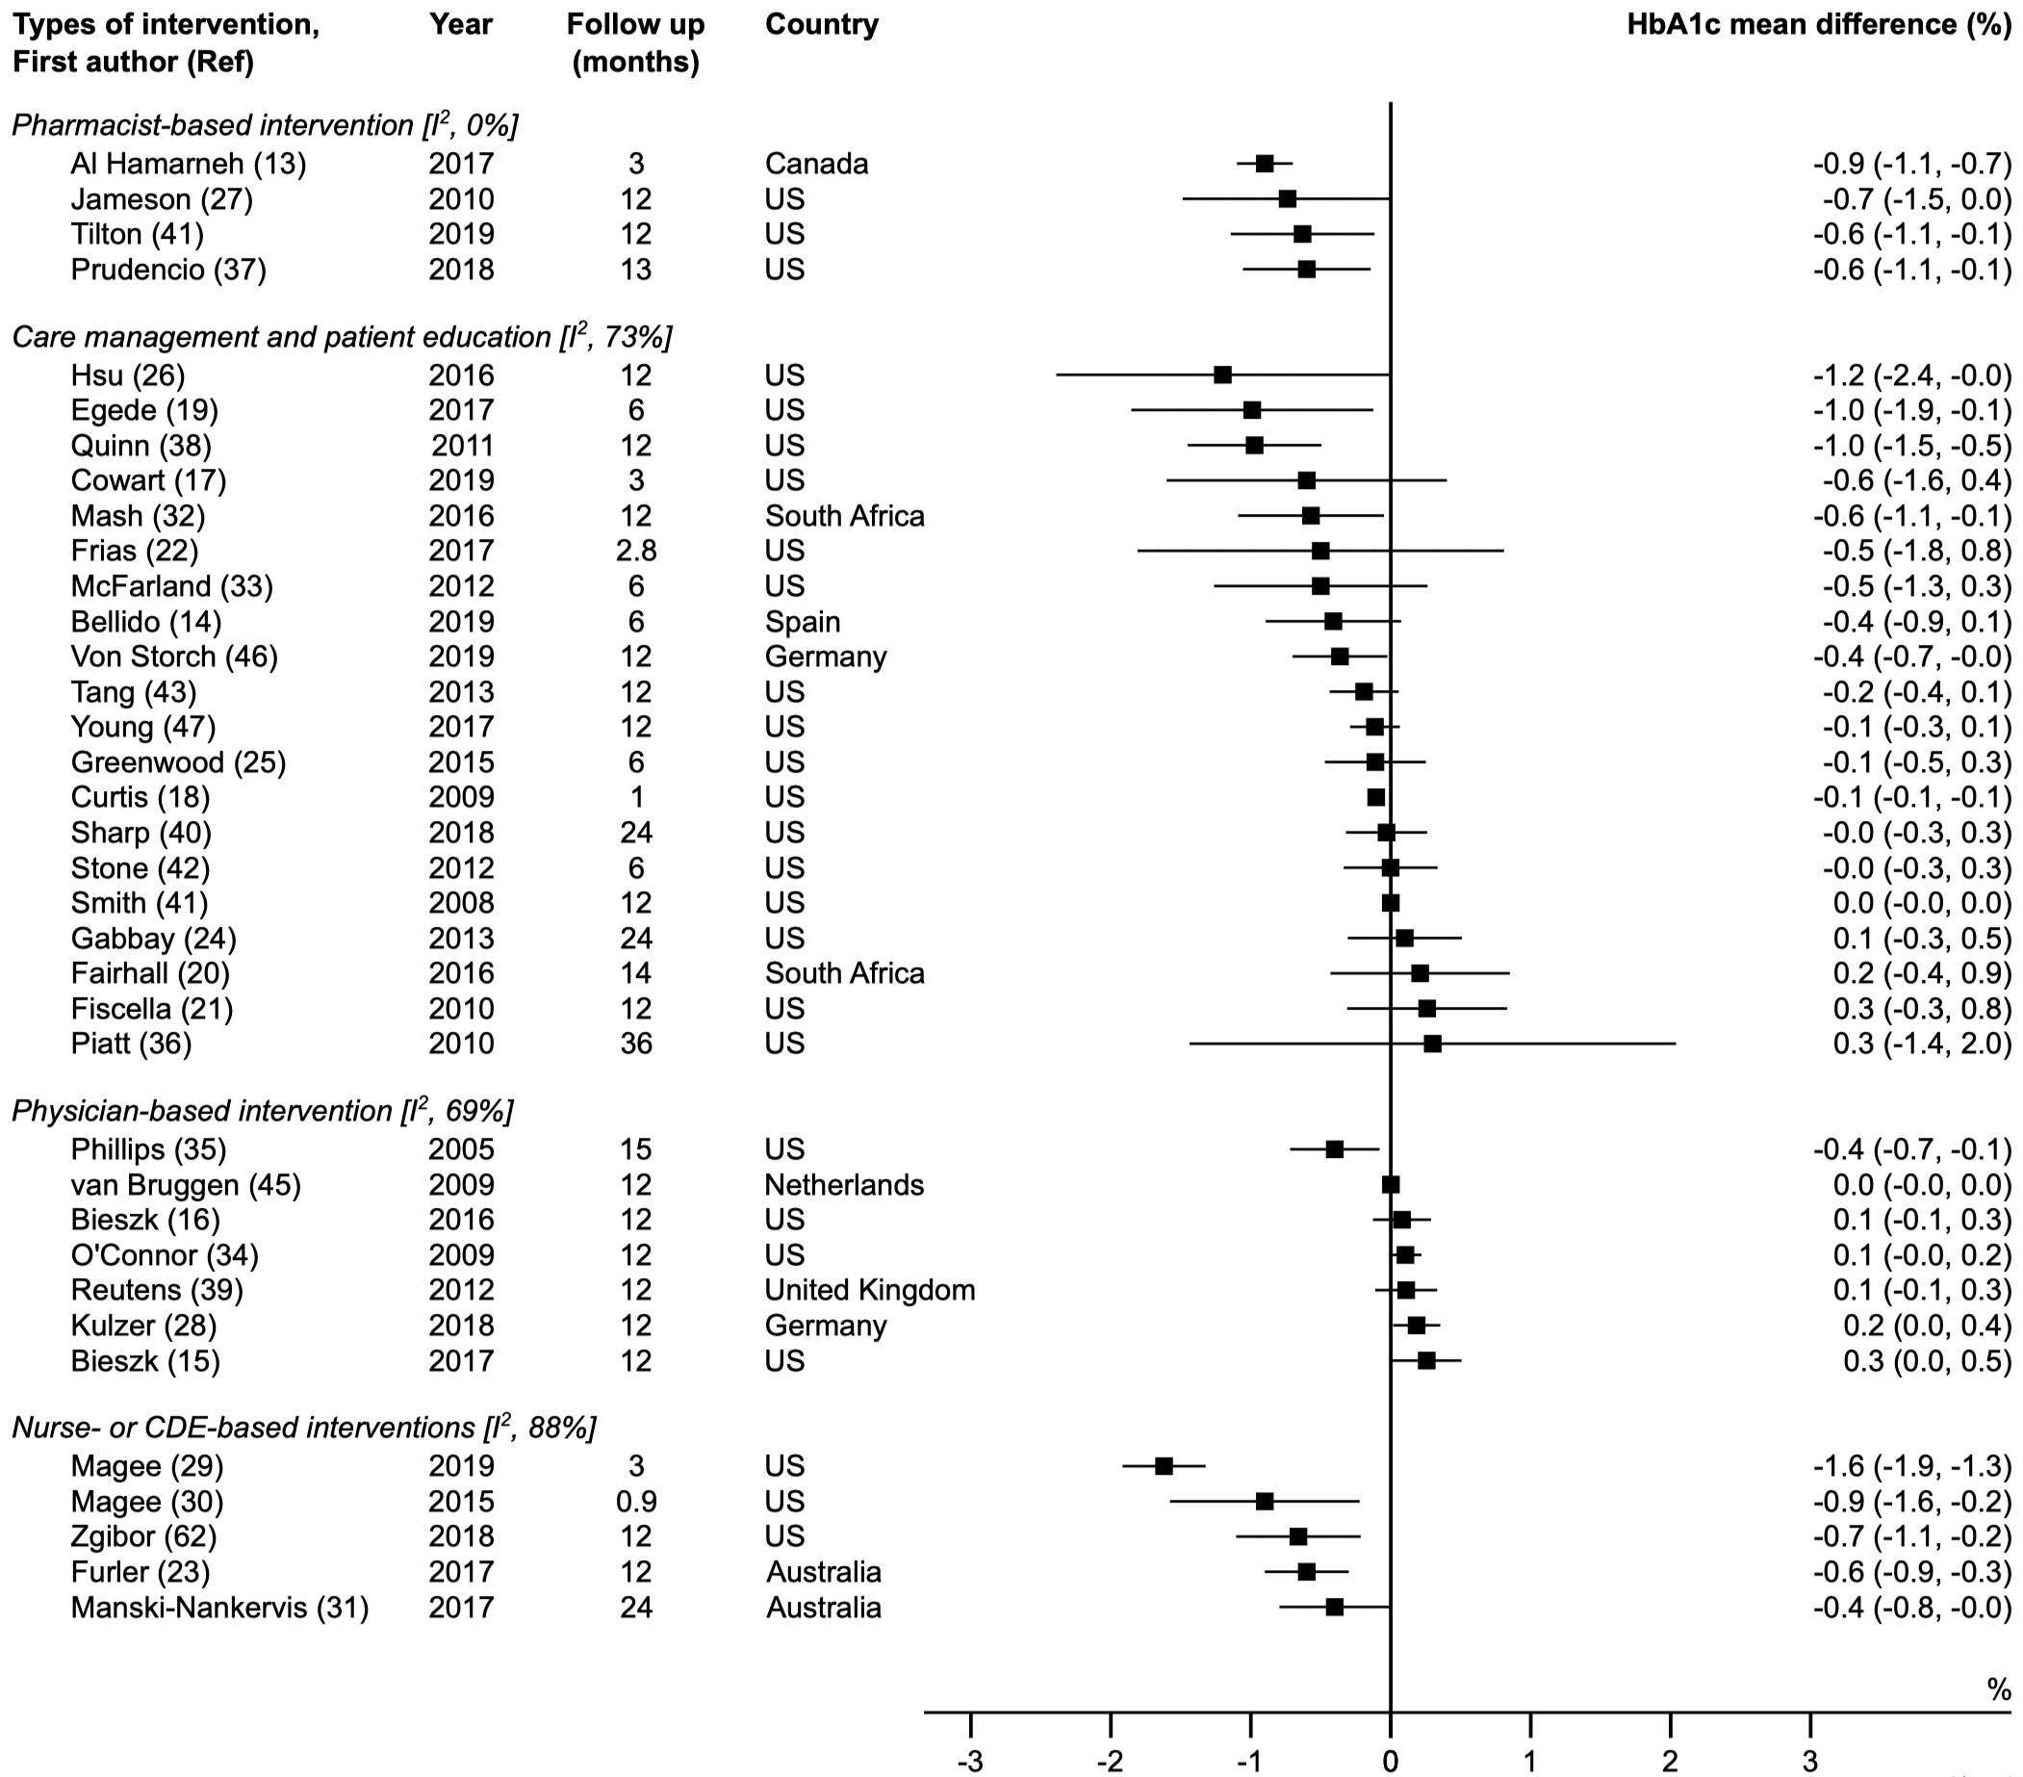
Meta-analysis: 36 studies categorized by primary type of intervention
Pharmacist-based
Care management and patient education-based
The most effective approaches to mitigating therapeutic inertia and improving A1C were those that empower health care professionals such as pharmacists, nurses, and diabetes educators to initiate and intensify treatment independently,
supported by appropriate guidelines.
Physician-based
Nurse or CDCES-based
Powell, Zaccardi, Khunti et al. Strategies for overcoming therapeutic inertia: A systematic review and meta-analysis. Diabetes Obes Metab. May 2021.
Square dot indicates average ∆ A1C for intervention, compared to control
Horizontal line indicates ± 95% confidence interval
Absolute reduction in A1C
Notes:
This forest plot is a visual representation of the results. The summary is below.
Squares and bars indicate study- specific mean A1C reduction compared to control arm and 95% confidence interval.
The further left from the center line, the greater the positive effect.
Of the 36 studies that met inclusion criteria:
20 were categorized as care management and education based
Outcomes were mixed with 5 showing clinically significant reductions in A1C
7 as physician-based
Only one associated with significant reductions in A1C
5 as nurse and DCES-based
All associated with significant reductions in A1C
4 as pharmacist-based
All associated with significant reductions in A1C

Slide 21
Strategies for Overcoming Therapeutic Inertia: A Systematic Review and Meta-Analysis
36 studies representing > 22,000 people with type 2 diabetes; Published 2004 through 2019: Duration of intervention 0.9 to 36 months
Reductions in A1C compared to usual care controls
Nurse or certified diabetes care and education specialist led
-1.62% to -0.40%
Care management /patient education led
-1.20% to 0.30%
Pharmacist led
-0.90% to -0.60%
Physician-based
-0.40% to 0.26%
Nurses, diabetes educators, and pharmacists empowered to initiate and intensify therapy independently supported by guidelines and protocols had the greatest reductions in A1C.
Powell et al. Strategies for overcoming therapeutic inertia:
A systematic review and meta-analysis. Diabetes Obes Metab. May 2021
Notes:
NOTE: This slide presents similar information that was presented on slide 20. Please choose between slides based on audience needs.
In 2021 the OTI steering committee requested an investigation of interventions to overcome therapeutic inertia on glycemic control in individuals with type 1 diabetes.
The systematic review and meta-analysis identified 36 studies that met the criteria; representing > 22,243 patients; median range of intervention .9 to 36 month. Interventions used were designed to intensify medication therapy, not medication adherence.
Studies were categorized based on the primary type of intervention into 4 groups:
Care management and patient education (included virtual coaching, telemonitoring, alerts, shared-decision-making (SDM) tools
Physician based- programs designed to influence physician behavior—education, feedback, and practice improvement
Nurse or certified diabetes care & education specialist (at the time referred to as CDEs) focusing on medication management
Pharmacist-based interventions enabling autonomy to review medications and make guideline-based adjustments
A1C reductions are shown here comparing intervention to control arms.
The most effective approaches to mitigating therapeutic inertia and improving A1c were those that empowered health care team members such as pharmacists, nurses and diabetes educators to initiate and intensify treatment independently, supported by appropriate guidelines.
Interventions that focused on changing clinician behavior through education, feedback or quality improvement were least likely to be associated with improved A1C.

Slide 22
Strategies for Overcoming Therapeutic Inertia: A Systematic Review and Meta-Analysis
Results may be less dependent on WHO (type of provider) intensifies therapy but HOW they intensify:
Nearly all care management and patient education interventions associated with significant A1C improvements used technology to support communication between team members and patients.
Delivery methods
Frequency of intervention and communication
Powell et al. Strategies for overcoming therapeutic inertia:
A systematic review and meta-analysis. Diabetes Obes Metab. May 2021
Notes:
The authors concluded that results may be correlated more with HOW therapy was intensified rather than WHO. How therapy was intensified included the delivery methods, the frequency of the intervention and the quality of the communication. It was clear that using technology to interact with patients helped clinicians improve A1C, as nearly all care management and patient education interventions was associated with significant A1C improvements when technology was used to support communication between team members and patients.
.
Using technology in the form of telemonitoring, text messaging, virtual visits, and mobile applications to support communication between patients and care managers or other team members was associated with statistically and clinically significant improvement in A1C.
Using technology in the form of telemonitoring, text messaging, virtual visits, mobile applications to support communication between patients and care managers or other team members was associated with statistically and clinically significant improvement in A1C.
Examples include:
Cloud-based diabetes management programs that enabled virtual visits, text messaging, shared-decision-making tools, and patient self-tracking tools.
A technology assisted case management telehealth glucose monitor
Mobile software application that supported automated coaching
Patient-provider portals.
.

Slide 23
Strategies for Overcoming Therapeutic Inertia:
Actionable Interpretation
Identify patients with suboptimal control and achieve glycemic goals in <6–12 months
Systems or practices looking to implement a medication management program may consider different team members who can use technology to support frequent communication with patients.
Reduction in A1C was observed in first year and primarily in patients with baseline A1C >9%
Powell et al. Strategies for overcoming therapeutic inertia:
A systematic review and meta-analysis. Diabetes Obes Metab. May 2021
Notes:
The meta-analysis illustrated that organizations could take action to overcome TI by identifying patients with suboptimal control i.e., at diagnosis or A1C >9%
Organizations can guide people with diabetes towards achieving glycemic goals in 3- 6 months if they use…
A team of clinicians, and
Technology to communicate and modify therapy with patients

Slide 24
Best Practice Actions to Overcome Therapeutic Inertia
Clinician-Related Strategies
Set clear glycemic goals and timelines with patients
Empower team members to independently manage medications (algorithms or protocols)
Use technologies to adjust therapy between A1C tests
Develop and refer to a team of clinicians and community resources
ADA Standards of Medical Care 2022
Notes:
In addition to the meta-analysis, best practices or strategies have been identified to overcoming therapeutic inertia. A few clinician-related strategies are identified on the screen.
Note: Summarize the list on the slide

Slide 25
Best Practice Actions to Overcome Therapeutic Inertia
Strategies for the Person with Diabetes
Recognize progressive nature of type 2 diabetes and progressive need to change therapy
Share in treatment decision making with clinicians; include SDOH
Seek information and learn to be a self-manager; attend DSMES services and MNT
Use technology to evaluate personal glycemic profiles
ADA Standards of Medical Care 2022
Notes:
Here are best practices for overcoming therapeutic inertia for persons with diabetes.
Note: Summarize the list on the slide

Slide 26
Best Practice Actions to Overcome Therapeutic Inertia
System-Related Strategies
Identify people with diabetes newly diagnosed or not meeting goals A1C >9%
Support, empower, and use team approach
Provide access to DSMES services
Address SDOH in community
Use technologies in office practices
ADA Standards of Medical Care 2022
Notes:
Here are best practices for overcoming therapeutic inertia from a system-related perspective.
Note: Summarize the list on the slide

Slide 27
Identifying and Evaluating Progress in OTI: Periodic Reporting
PWT2D in EHR
#A1C >9%
#A1C >7-8.9%
A1C in past 6 mo.
Visit in past 6 mo.
Treatment change
Notes:
We know therapeutic inertia exists in practice as numerous studies identify and only 50% of persons with diabetes are at glycemic goal.
However, we cannot tackle a problem until we identify the magnitude.
Using electronic health record data, we can identify who is not achieving target goals and understand why.
Have they had an A1C in the past 6-12 months?
Have they visited in past 6 months?
If they have, was there a therapy change?

Slide 28
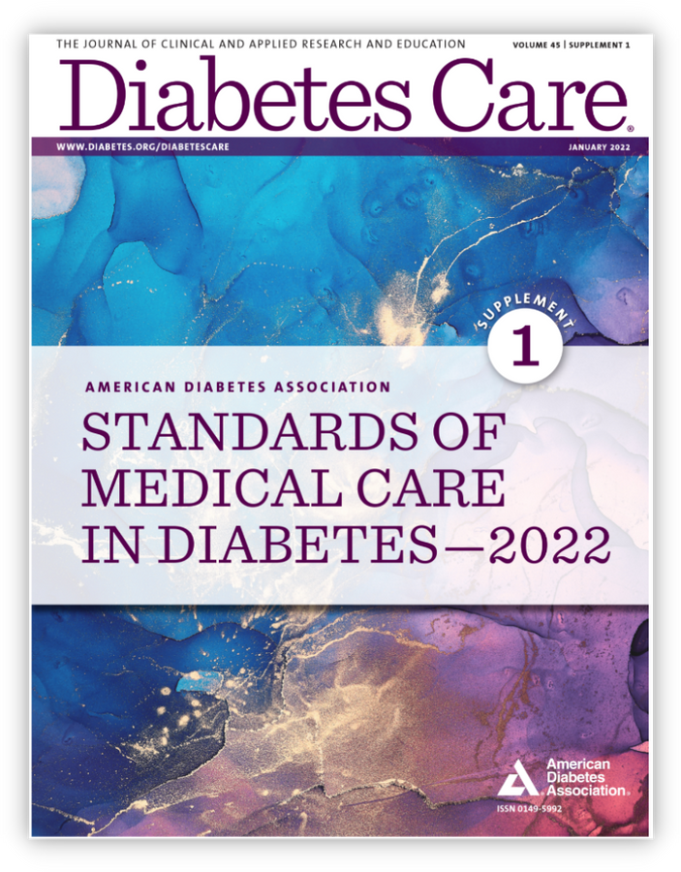
The ADA’s Standards of Care: Always Up to Date
Approach to Medication Therapy in Type 2 Diabetes
Algorithms
Guidelines for intensification of therapy
Customized protocol
Check out the app!
professional.diabetes.org/SOCApp
Notes:
You are not alone.
There are many resources to help you in tackle therapeutic inertia.
The ADA Standards of Care is available and always up-to-date with treatment algorithms, guidelines for intensifying therapy and customized protocol.
The web app is also available for easy to use. Go to professional.diabetes.org/SOCApp

Slide 29
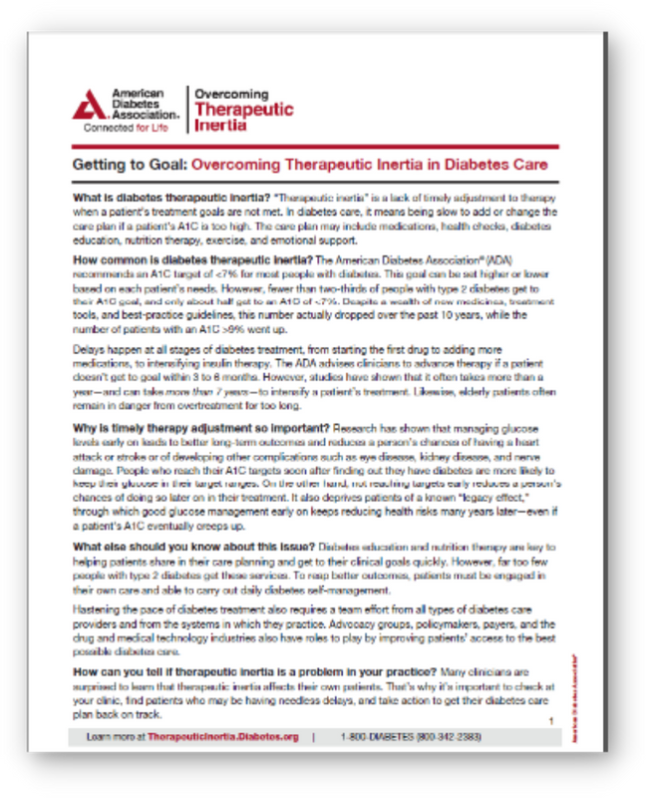
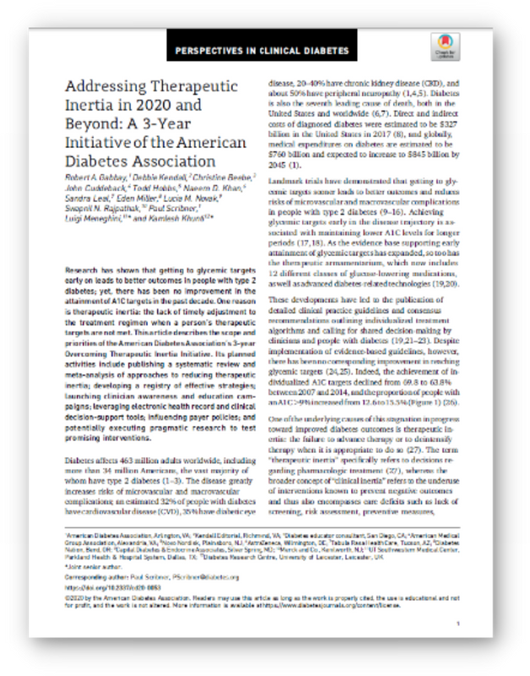
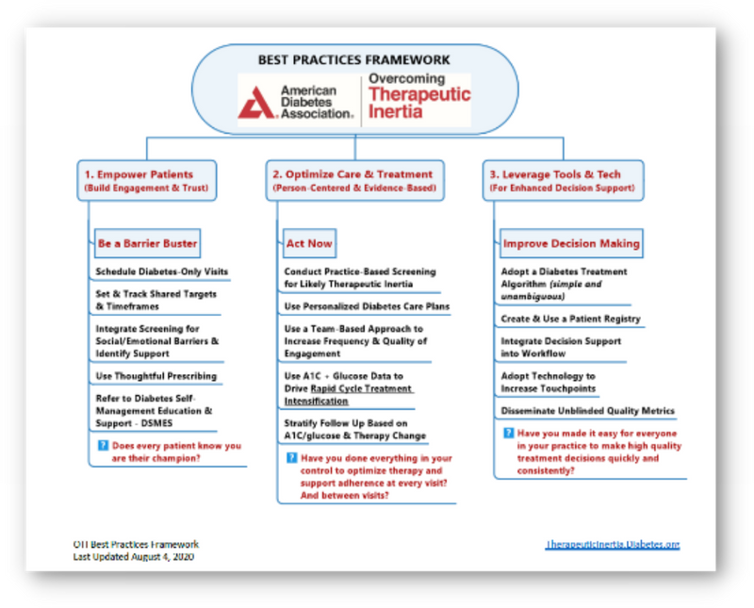
OTI: Patient, Clinician, and Practice Resources
Download:
Fact sheet
Best practices framework
White paper
Systematic review
Patient/provider toolkit
Webinar series
Learn more at TherapeuticInertia.Diabetes.org.
Notes:
Visit the therapeutic inertia website at therapeuticInertia.dabetes.org and take the TIQ self assessment to gain insight into your level of understanding of how therapeutic inertia plays out in clinical practice.
Download OTI one-pager and share with members of your team.
Identify at least one modifiable strategy to improve TI in your organization and who needs to be engaged for success.

Slide 30
Overview for Tackling Therapeutic Inertia
Learn more at TherapeuticInertia.Diabetes.org.
Notes:
Here is screenshot of a one-page infographic that outlines steps you can take to overcome therapeutic inertia. The handout can be found on the Practice Improvement page on ADA OTI website at TherapeuticInertia.Diabetes.org. Please share this infographic with colleagues to initiate conversation about strategies for overcoming therapeutic inertia.

Slide 31
ACT Urgently
Early glycemic management:
Saves life, limb, and sight
Saves time and money for our patients
Saves health care costs for our organization
Addressing contributors to therapeutic inertia at the patient, practice, and system level will change the course of your patients’ health outcomes.
Notes:
The key message is to ACT with a sense of urgency.
Early glycemic management can save life, limb and sight!
Early glycemic management can save time and money for people with diabetes!
Early glycemic management can save health care cost for the organization!
You have what it takes to change health outcomes for people with diabetes. Let’s do it now!

Slide 32
WHO?
What’s next to overcome therapeutic inertia in our organization?
HOW?
WHAT?
WHEN?
WHERE?
Notes:
Are you interested in knowing what to do next to overcome therapeutic inertia in our organization?
Download the Implementation Guide on the OTI website for additional details on how to implement strategies to reduce or eliminate therapeutic inertia in your organization.

Slide 33
Thank you!
therapeuticinertia.diabetes.org

